Slide 1
PARADISE RECREATION & PARK DISTRICT
Proudly Presents the 9th Annual
Opens November 18th, 2022 through January 8th, 2023
SPONSOR OPPORTUNITIES

Slide 2
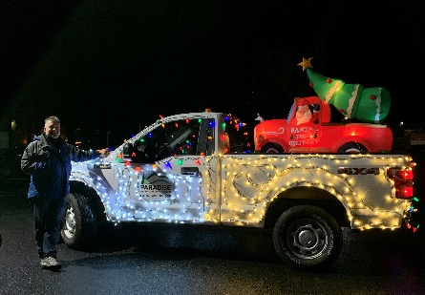
EVENT PROFILE 2021-22 Paradise on Ice - Winter Wonderland
We transform the Terry Ashe Recreation Center into a Winter Wonderland:
A Paradise tradition now in its 9th season!
7-week holiday season
Festive décor
Appeals to all ages in a family friendly atmosphere
4,000 sq. ft outdoor ice rink
A complete experience: all that guests need to enjoy skating.
Comprehensive list of events beyond skating: art, music, food
Enough fun and merriment to create memories for our entire community.
Notes:
Now in its 8th season, we transform the Terry Ashe Recreation Center into a Winter Wonderland with festive décor, a 4,000 sq. ft outdoor ice rink, and enough fun and merriment to create memories for our entire community.
This Paradise tradition appeals to all ages in a family friendly atmosphere that continues throughout the holiday season.
The ice rink comes with all that we need for guests to enjoy skating. We also plan for room for events, art, music, food, and fun beyond skating to engage guests as well.
Your sponsorship of this event supports our community and provides a strong beacon of hope and support as we Rebuild the Ridge and Paradise.

Slide 3
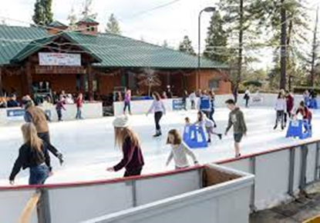
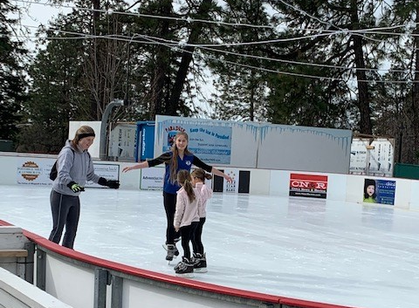
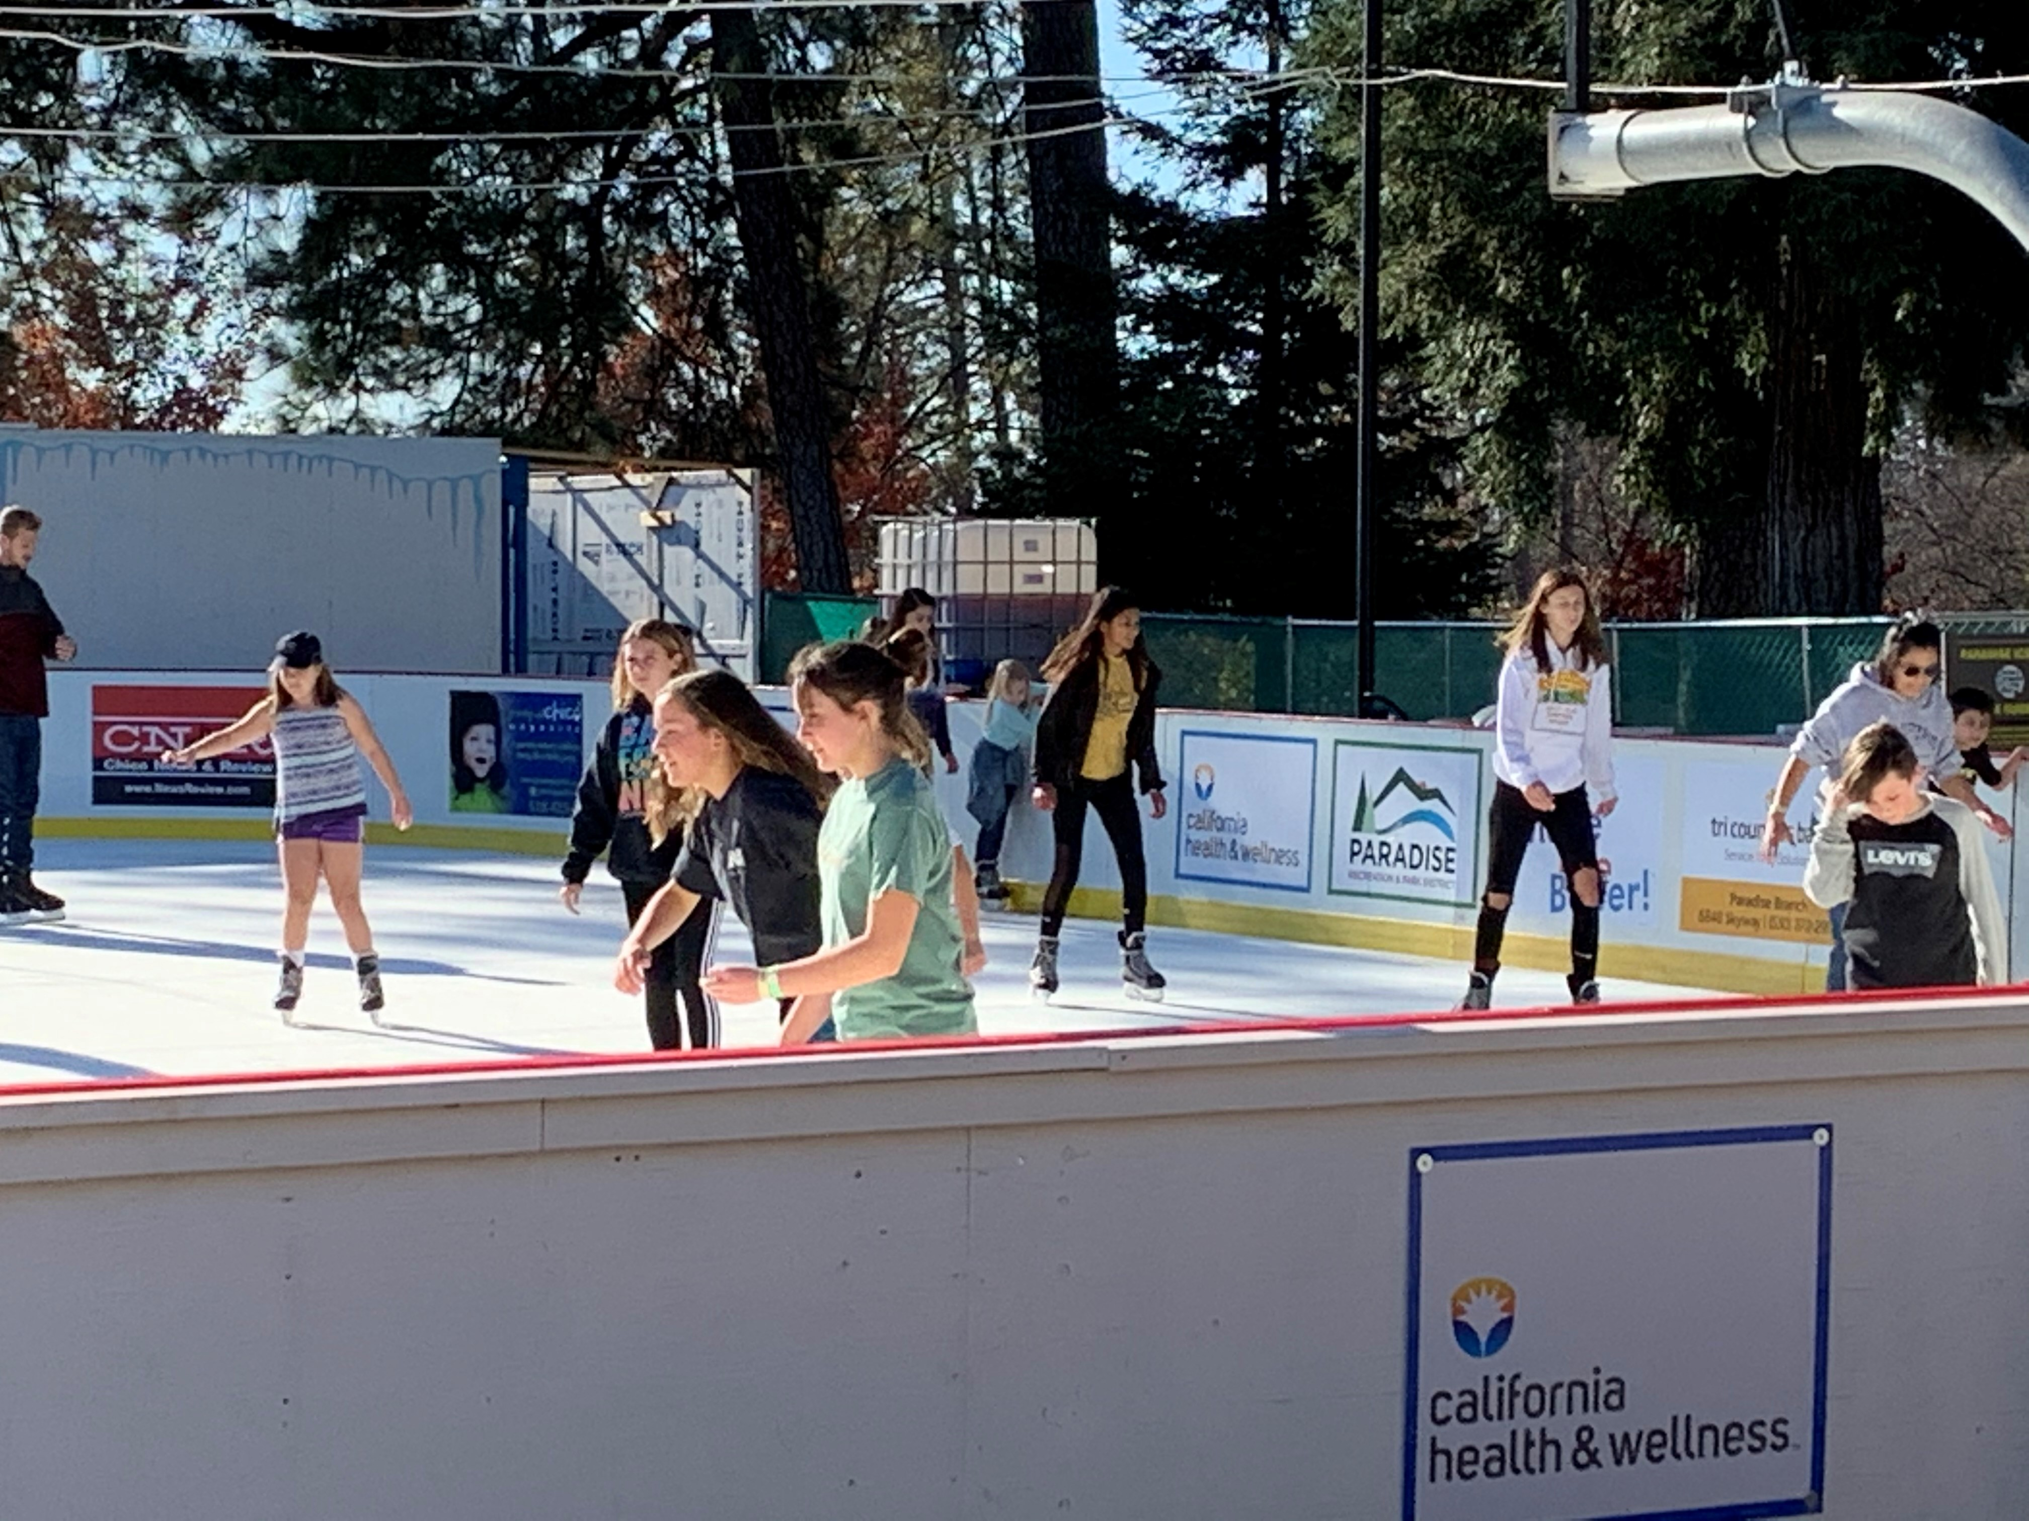
Your sponsorship supports Paradise and ensures that we maintain this tradition and source of pride for our community.

Slide 4
EVENT AUDIENCE
A Paradise Tradition that brings the region together during the heart of the holiday season.
The 9-week event attracts people from throughout Northern California.
Sponsorship provides a perfect opportunity to showcase your business’s distinctive branding, marketing, and gratitude for new and active customers and demonstration of support for Paradise, CA.

Slide 5
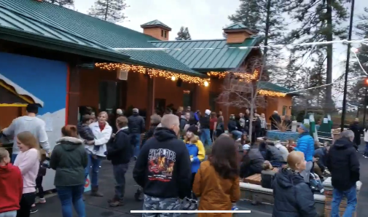
AUDIENCE DEMOGRAPHICS
Thousands of fun-loving guests support Paradise!
Let’s get to know them!

Slide 6
EVENT PROMOTIONS & MEDIA PROMOTION
The Paradise Ice Rink is a local tradition that generates media coverage on a regular basis. We have a concerted media efforts that includes:
TELEVISION/RADIO - Local & regional stations
PRINT - Regional and local newspapers & magazines
SOCIAL MEDIA - Facebook and Instagram posts with photos and videos (visitor generated content too!).
EMAIL - Customized email promotions
Electronic Sign – At event location
GRASS ROOTS - Up to 5,000 flyers, 200 posters, 25 banners & 50 yard signs will be distributed to Butte County businesses, shops, local events, streets and banner locations
EVENT CALENDARS - Event calendar listing in Regional calendars

Slide 7
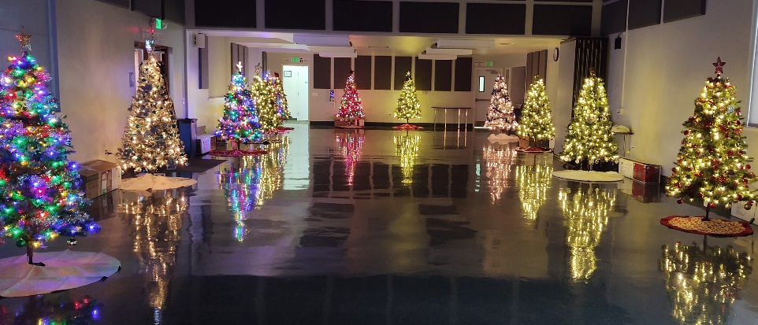
UPCOMING EVENTS
Santa’s Arrival, Community Tree Decoration, Christmas Tree Lighting, & Lighted Truck Parade
Ice skating lessons
Holiday Craft Faire
Subaru Skate Day
Pinewood Derby Race
Business Sponsored ½ price skate Days
Christmas Carnival & Fire on Ice
Teen Disco Nite
Cornhole tournament and Chile Cookoff

Slide 8
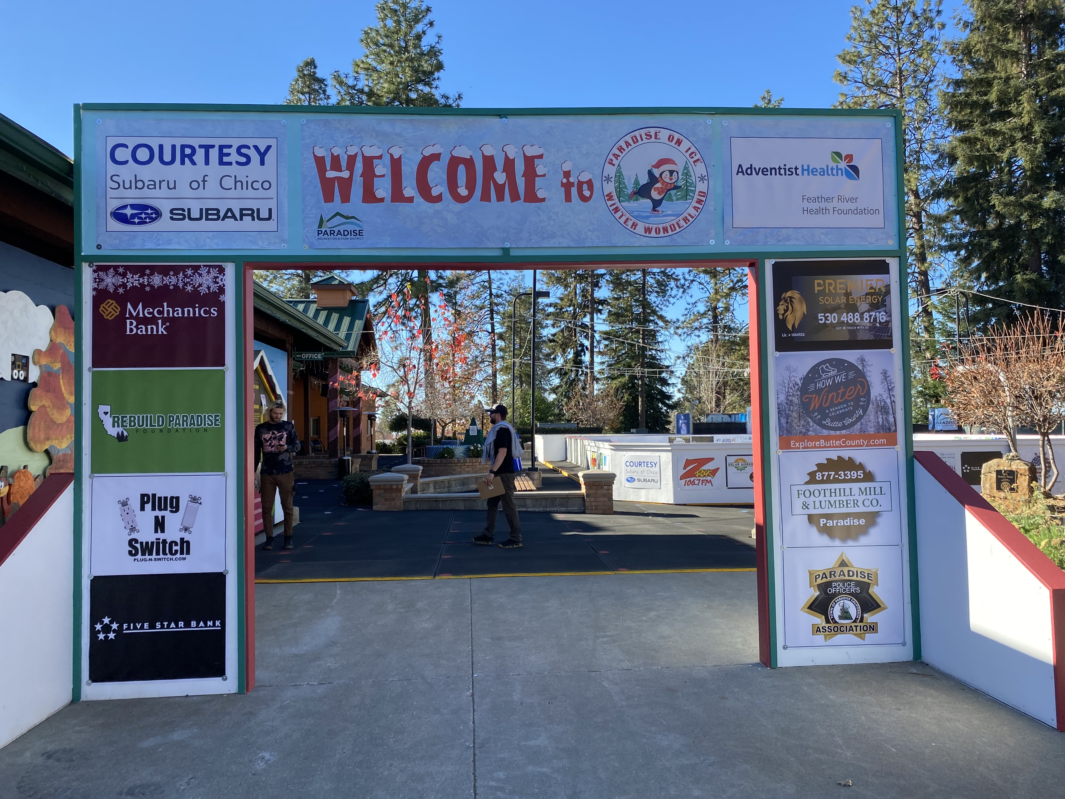
PARADISE on ICE – WINTER WONDERLAND ENTRANCE
(Grab your Spot on the New Entryway to the Paradise on Ice Winter Wonderland)
Sponsor Levels
TITLE–TRIPLE LUTZ
PRESENTING–DOUBLE LUTZ
OFFICIAL–SINGLE LUTZ
PENGUIN TOE JUMP
AXEL JUMP
FRIENDS of the RINK
Event Sponsors

Slide 9
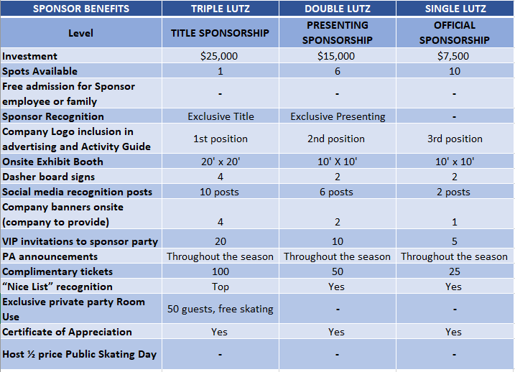
PARADISE on ICE- SPONSOR PACKAGES

Slide 10
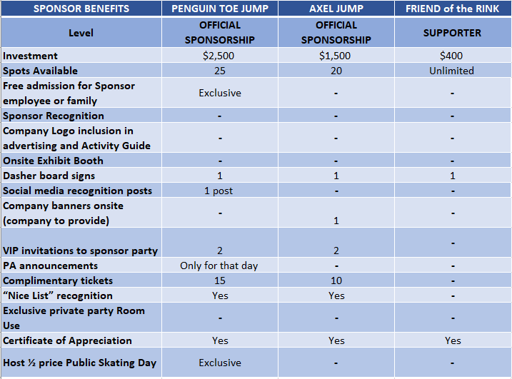
PARADISE on ICE- SPONSOR PACKAGES

Slide 11
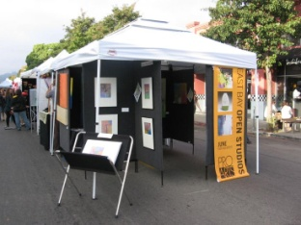
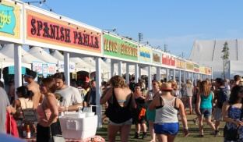
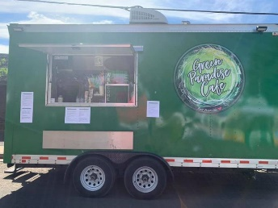
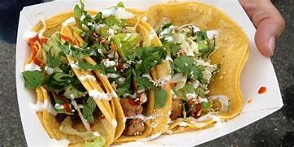
VENDOR, EXHIBITOR, ATTRACTIONS & FOOD TRUCK SPOTS
Vendors to set up booths around the event. The Holiday Craft Faire will support several vendor booths for products. Dates to be determined.
10’ x 10’ Display Space on-site – Arts & Crafts (Non-Commercial) $100
10’ x 10’ Display Space on-site – Attraction & Special Event $100
10’ x 10’ Display Space on-site – Commercial Merchants $200
10’ x 20’ Display Space on-site – Arts & Crafts (Non-Commercial) $200
10’ x 20’ Display Space on-site – Commercial Merchants $400
10’ x 10’ Food Vendor $100
10’ x 25’ Food Truck $150
Deposits –
All food vendors/trucks are required to pay a $50 deposit (refundable).
*Prices of the booths are per week.

Slide 12
ANCILLARY SPONSOR EVENTS & ATTRACTIONS
Additional events and attractions can be sponsored to gain more brand exposure. These are below:
$3,500 Package & Sponsor Fee
MAIN STAGE Sponsor
$2,500 Package & Sponsor Fee
KIDS ZONE Sponsor
CRAFT BREW GARDEN Sponsor
YOUTH ICE HOCKEY Sponsor
CHRISTMAS TREE Sponsor
LIGHTING Sponsor
CHILI COOK-OFF Sponsor
PINEWOOD DERBY Sponsor

Slide 13
PARADISE on ICE wants to THANK our 2019-2020 SPONSORS

Slide 14
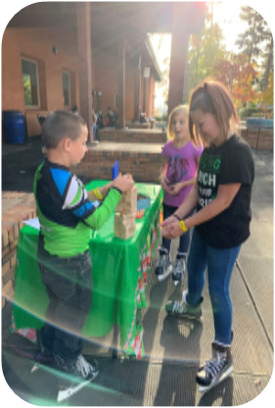
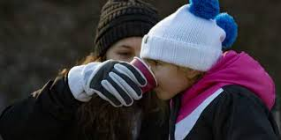
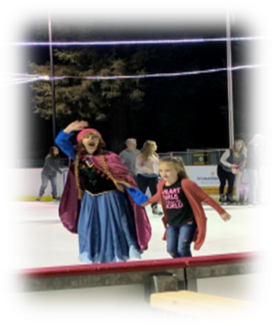
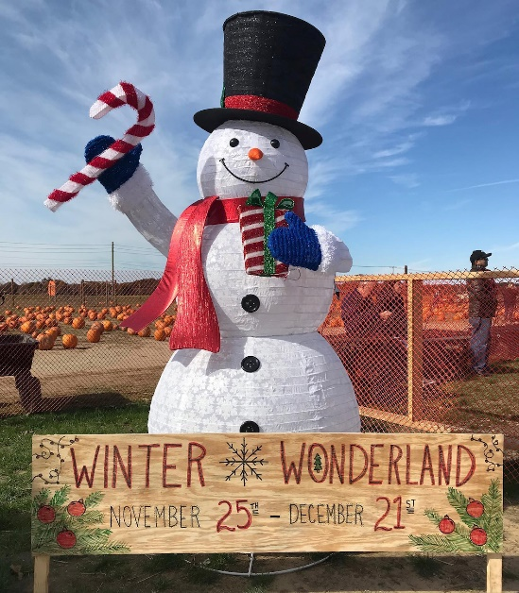
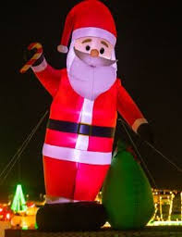
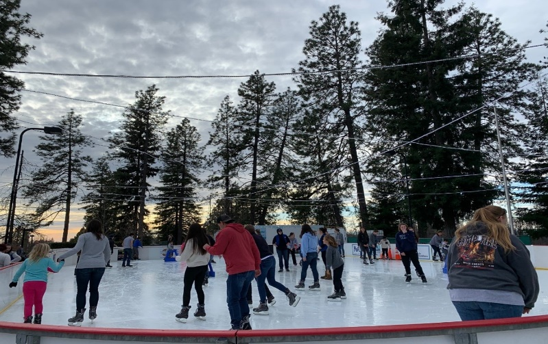
COME AND JOIN US IN 2022-23 !!

Slide 15
GOLD (OFFICIAL) SPONSORSHIP
Logo Inclusion (3rd Position)
Media Ads & Marketing
On-Line, Social Media, Print, Posters, Flyers
1 - 10’ x 10’ Display Space on-site at the event
Single Dasher Board Signage with your company logo
2 - Company Banners on-site
(company to provide)
Logo in the PRPD Activity Guide
4 - VIP invitations to Sponsor party hosted by PRPD
2 - PA announcements per day
20 complimentary tickets
Certificate of Appreciation
$2.500 investment (10 positions)
SILVER SPONSORSHIP
Thank You to Our
COMMUNITY PARTNERS
Town of Paradise
Paradise Ridge Chamber of Commerce
Explore Butte County

Slide 16
CONTACT US FOR MORE INFORMATION ON SPONSORSHIP OPPORTUNITES
Blue Sky Event Services
Forrest Melton
(949) 891-3254
BlueSkyFestivalsAndEvents@gmail.com
Paradise Recreation and Park District
Lorrennis Leeds
Ice Rink Manager
(530) 872-6393
lleeds@paradiseprpd.com

